Slide 1
Time Management
(for technical people)
Dónal Cunningham

Slide 2
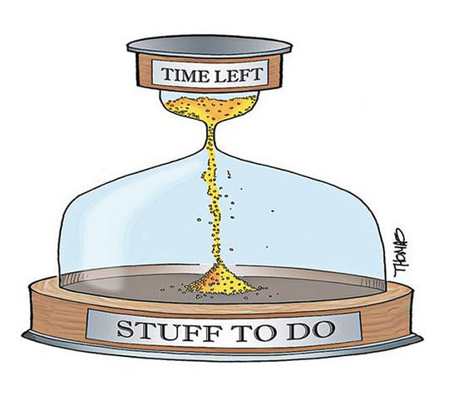
Notes:
Intended audience – technical people
Interrupt-driven
Not afraid of technology

Slide 3
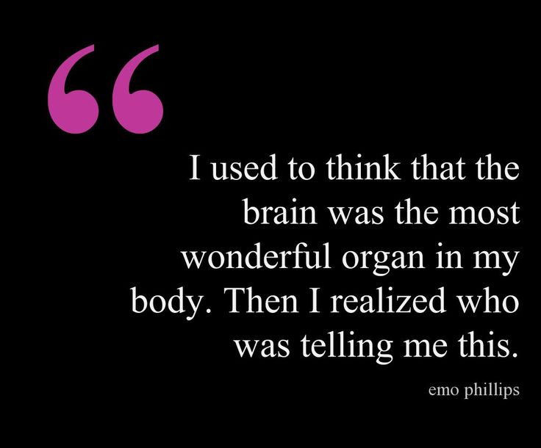
Notes:
Your brain LIES to you
Free it up for DOING THINGS, not REMEMBERING THINGS

Slide 4
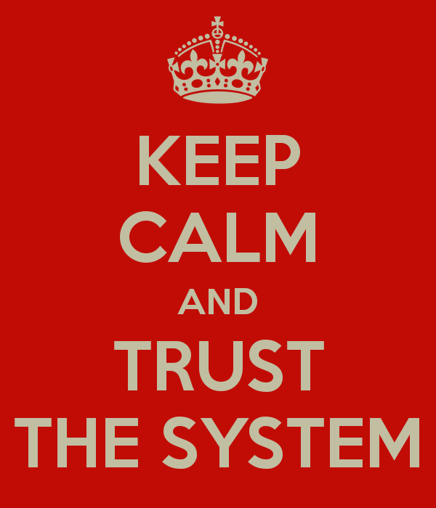

Slide 5
Non scriptum, non Est
(write it DOWN)
Notes:
“Can you do one small thing for me?”
Send an email!
Long term vs. what should I be doing today?

Slide 6
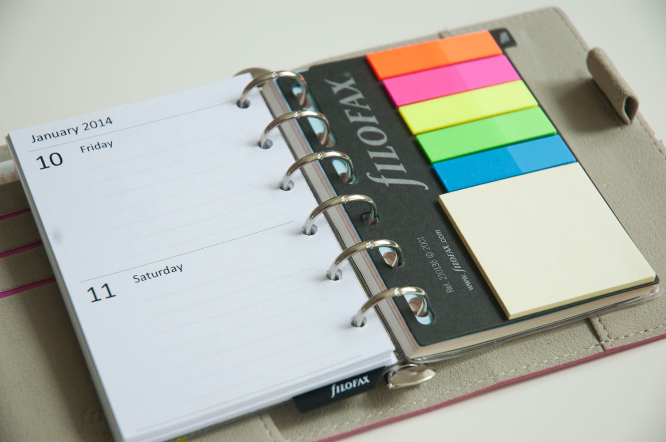
Notes:
Dad still uses a little pocket diary

Slide 7
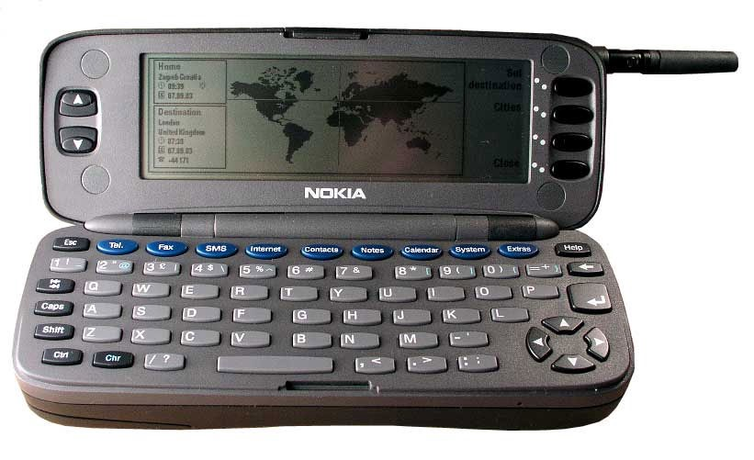
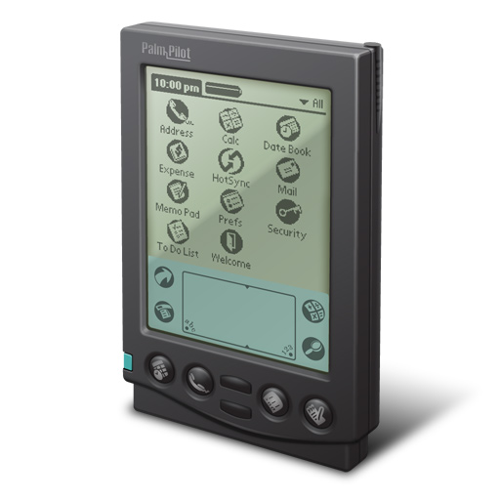

Slide 8
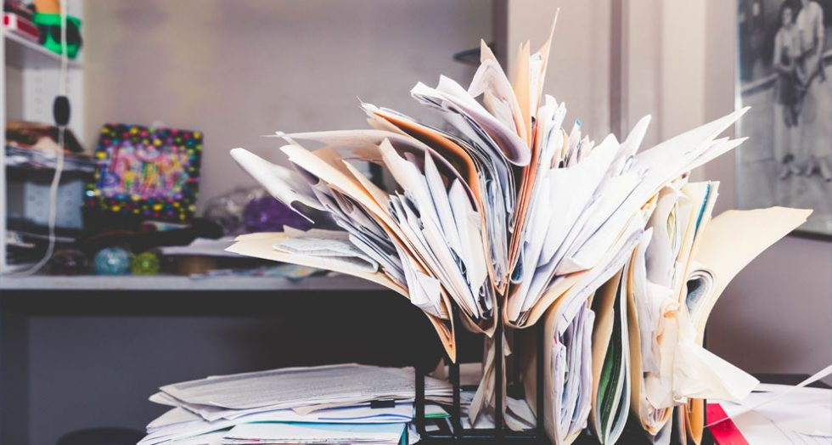
Notes:
Gathering points
Email
Tickets
Meetings

Slide 9



Notes:
Corridor tasks
Send an email but give them the words to use

Slide 10

Because when I mark something as complete
IT STAYS ON THE DAMN LIST

Slide 11
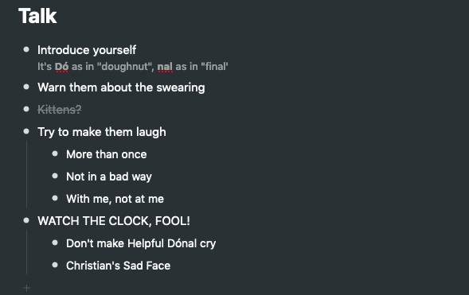

Slide 12
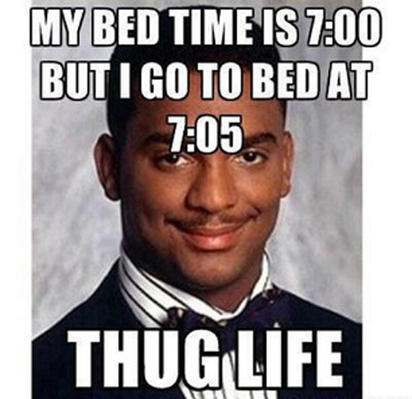

Slide 13
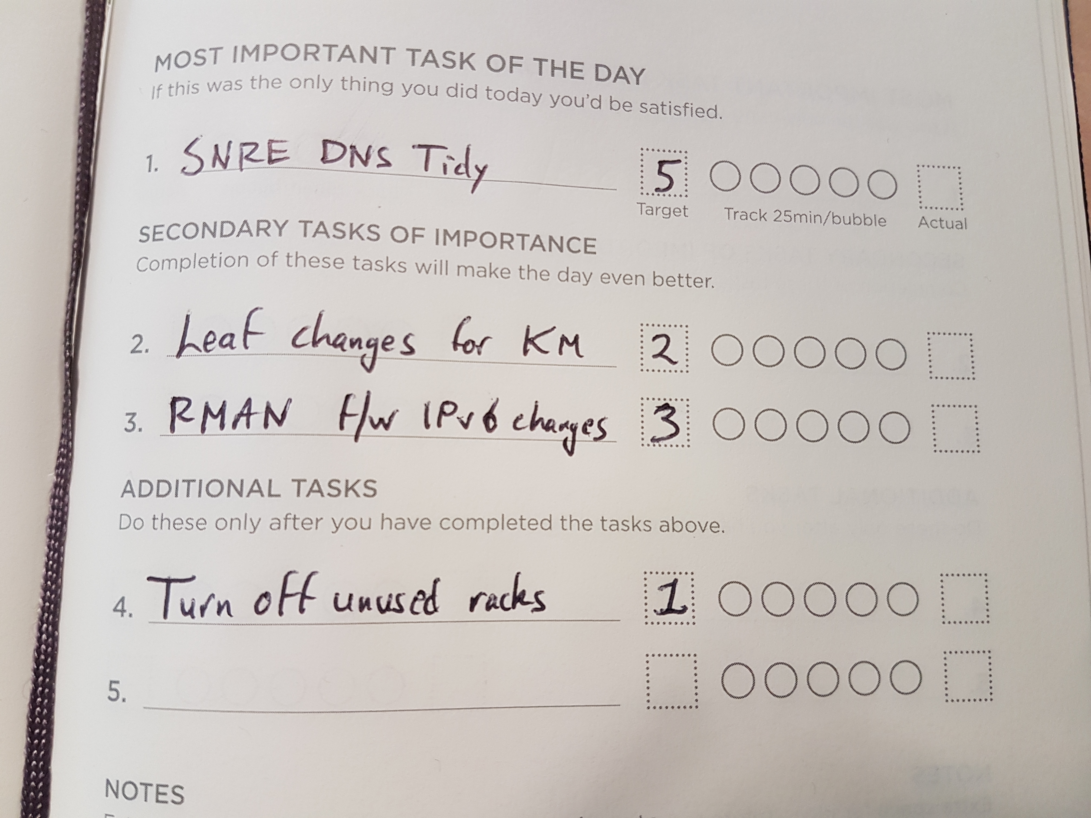
Notes:
I might only get ONE THING DONE TODAY? Shut the front door.

Slide 14
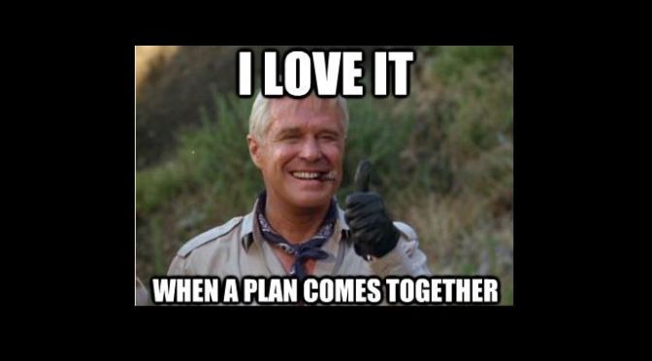
Notes:
First Thing Every Morning
You can do this before coffee!

Slide 15
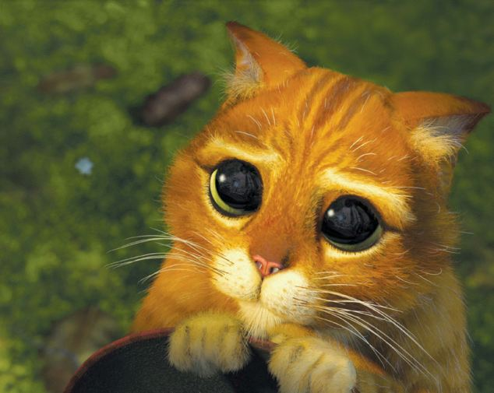
Notes:
P4s need love too

Slide 16
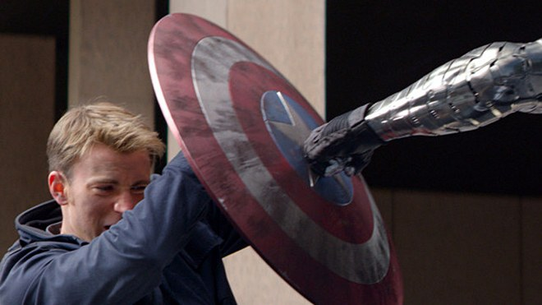
Notes:
Can you swap morning and afternoon?
Can you get project time every day? Week?
When you are interrupted, write it down so you remember!
Evidence for the prosecution (Toggl?)

Slide 17
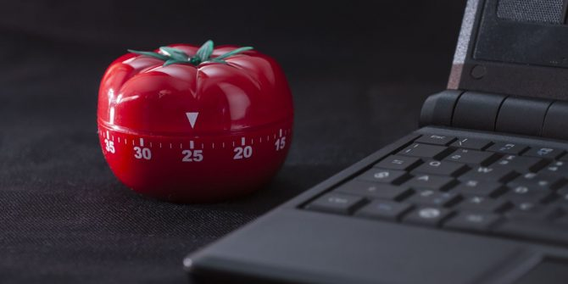
Notes:
Callback to productivity planner
Don’t interrupt yourself!

Slide 18
References
Help! I have a manager! (wizardzines.com) Julia Evans
Time Management for System Administrators Tom Limoncelli
https://noidea.dog/ Tanya Reilly
https://www.intelligentchange.com/products/the-productivity-planner
https://github.com/aughera/softpath

