Slide 1
An Irish IPv6 Fairytale iNOG:A meeting
24th November 2016
Orla McGann

Slide 2
Who are HEAnet?
Who are HEAnet?
We’re Ireland’s National Research and Education Network (NREN)
Notes:
Before our tale begins, a little background…

Slide 3










Notes:
We provide Internet connectivity and network services to all the Universities, Institutes of Technology, Primary & Secondary Schools and anyone related to education that’s publicly funded in Ireland.

Slide 4
Once upon a time…
This is a story of the long and winding journey of IPv6 adoption in Ireland’s Academic & Research network
With various villains (6to4 Tunnels, NAT, vendor bugs…) and heroes along the way...

Slide 5
6Bone and RIPE Allocations
Initially we applied for 6Bone address space to begin testing IPv6 in June 2001. We were allocated 3FFE:8037::/34
We received our RIPE allocation in October 2001 2001:770::/35 (later expanded to 2001:770::/32)
[orlamg@shankill orlamg]$ whois 2001:0770::/35
% This is the RIPE Whois server.
inet6num: 2001:0770::/35
netname: IE-HEANET-20011008
descr: Irelands Academic and Research Network
country: IE
admin-c: HN678-RIPE
tech-c: HN678-RIPE
mnt-by: RIPE-NCC-HM-MNT
mnt-lower: HEANET-NOC
changed: hostmaster@ripe.net 20011008
source: RIPE
Notes:
One of HEAnet’s functions is to operate as a Local Internet Registry for our Clients.
6Bone was the official IPv6 test bed project to allow Network Operators to start working with IPv6
Then we applied for address space from RIPE
6Bone project was officially deprecated on 6/6/2006 – because as we all know, IPv6 was fully in production then :)

Slide 6

1st Assignment
We assigned the first IPv6 block outside of HEAnet infrastructure to David Malone & Mike Knell in Trinity College Dublin November 2001.
INEX received their assignment 14th April 2003
“Although you requested a /64 address space assignment, HEAnet allocate a /48 to each of our customers who request IPv6 space.”
Notes:
We provide Internet Transit to INEX, and offered them IPv6 Transit in too.
Image credit: http://gallery.yopriceville.com/var/resizes/Free-Clipart-Pictures/Cartoons-PNG/Cinderella_Glass_Slipper-PNG_Vector_Clipart_Image.png?m=1434443102

Slide 7
The Case for IPv6
“The move to IPv6 will rejuvenate the infrastructure of the Internet. While it is invisible to most end-users, the IP protocol is a fundamental technology that allowed the development and wide deployment of the Internet as we know it, and allowed researchers and entrepreneurs to develop new services and products unhindered by geographic location.”
Email to DCMNR Nov 2003 - “The case for IPv6”
“This leaves Ireland with the opportunity to take a leading position in IPv6 deployment. Quite some progress has already been achieved. Teams at the major ISPs are working, to a greater or lesser extent, on IPv6 and production IPv6 service has been rolled out on HEAnet's national backbone, which is now ready to connect customers natively or via a number of transition mechanisms”
“While good progress has been made so far, there are a number of obstacles preventing the widespread deployment of IPv6 in Ireland and elsewhere.
Chief among these is inertia.”
Notes:
Brendan Touhy in DCMNR came to the HEAnet conference in 2003 and was listening to us present on IPv6 and asked us to write a brief on The Case for IPv6.
Little did she know, but my colleague Anna was very astute when she wrote “While good progress has been made so far, there are a number of obstacles preventing the widespread deployment of IPv6…”
What we weren’t expecting was for Brendan to decide to send our “Case for IPv6” to Vint Cerf and Brian Carpenter who co-authored some of the IPv6 Internet Drafts for comment!!
Luckily for us, it seems they thought it was quite on point bar a few quibbles…And this email led to the establishment of the Irish IPv6 Task Force with DCMNR.

Slide 8
Getting v6 Transit
Not an easy task in 2001…
First we peered at StarTap in Chicago to connect to 6TAP
Later we got IPv6 Tunnels to various Tier1 Transit providers - UUnet (UK), Chello (NL)…
Notes:
Once we had our IPv6 Address space we were able to get started on getting connectivity…
6TAP was a co-sponsored project by ESnet and CANARIE, provides native and tunneled IPv6 interconnections at STAR TAP, to provide early IPv6 production networks the ability to build and demonstrate IPv6-based applications

Slide 9
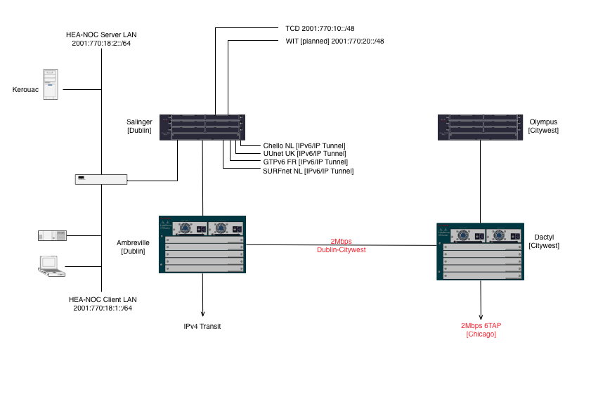
HEAnet’s IPv6 Network circa 2002
Notes:
A whopping 2Mbps to Chicago over the STM-1 circuit

Slide 10
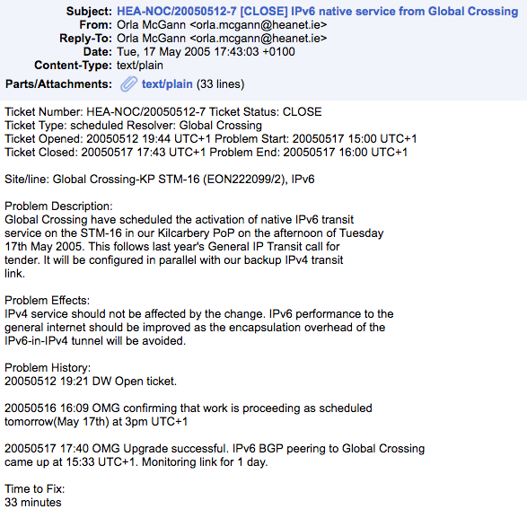
Native IPv6 Transit
May 17th 2005: Native IPv6 Transit from Global Crossing was established
So long Tunnels!!
Notes:
This was an exciting day on the IPv6 Internet because earlier that morning we noticed a problem that Geant weren’t advertising our IPv6 range to the other European NRENs,
and traffic was arriving via our Abilene link in New York.
20050517 09:03 OMG Geant were filtering out our IPv6 prefixes, which resulted in traffic from NRENs in Europe coming via our Abilene link in
New York. Mailed the Geant NOC and they have remedied this. Traffic from European NRENs now coming via Geant directly.
Nor was it all smooth sailing with GBLX native v6…we soon found out the quality of IPv6 transit was not the same as IPv4 transit and a lot of prefixes were missing.

Slide 11
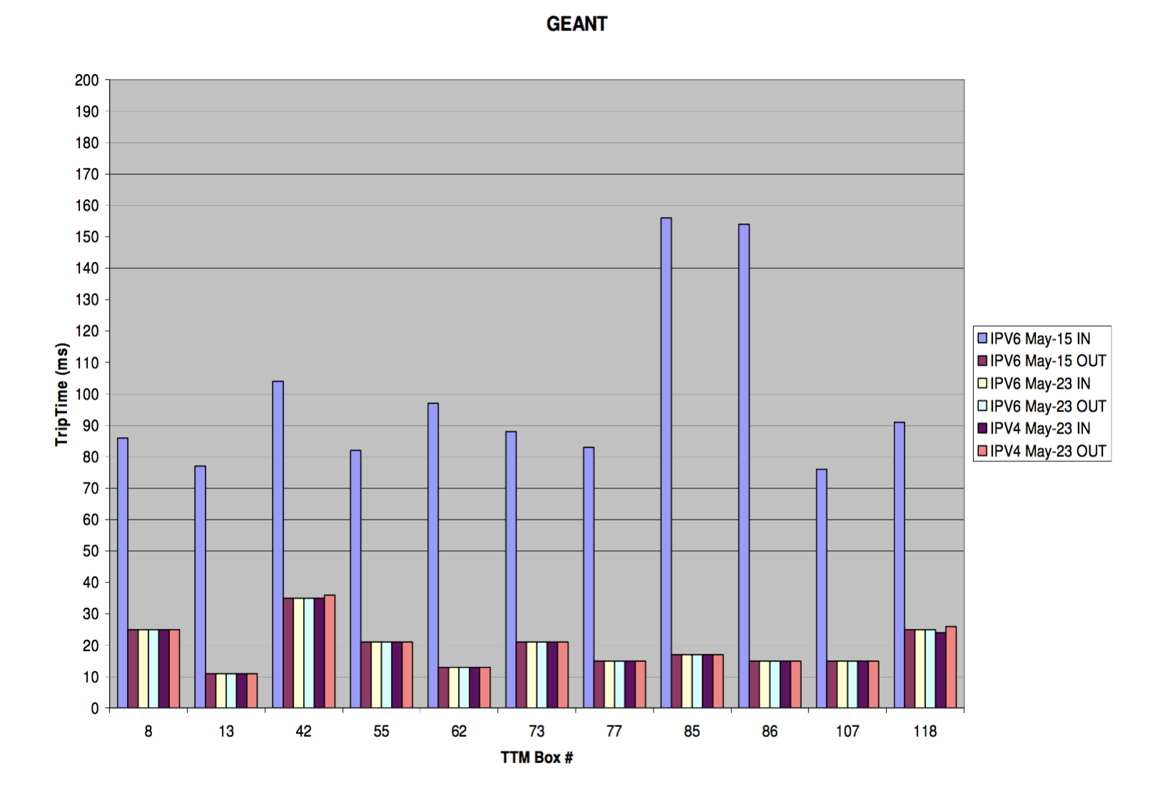
Notes:
Graph of RTT improving to the same as IPv4 after implementing Native IPv6 transit

Slide 12
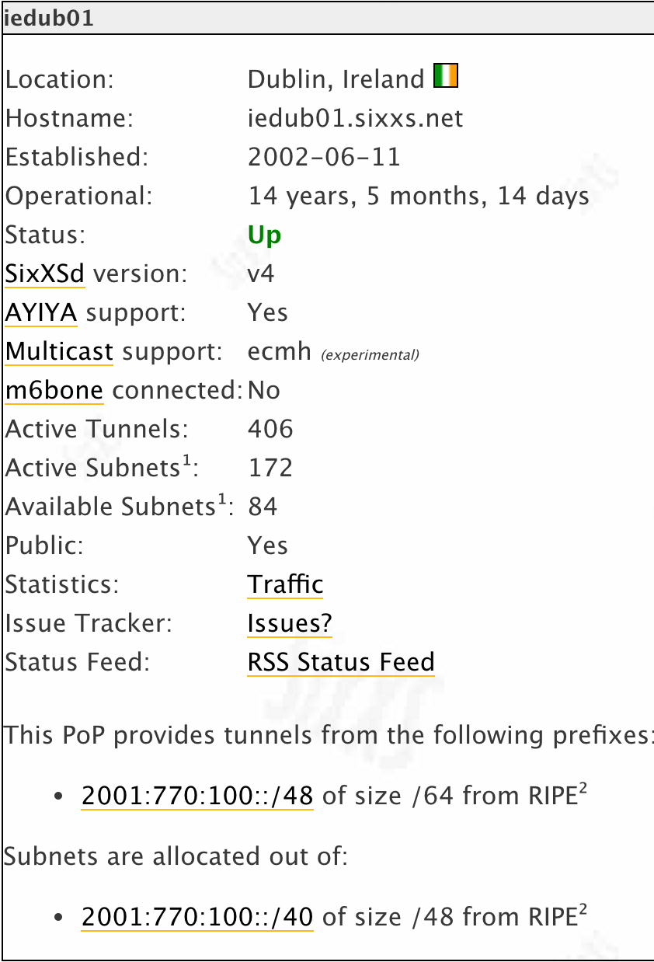

SixXS
HEAnet has hosted the first SixXS
node in Ireland…since 2002
Notes:
(ref: https://www.sixxs.net/pops/heanet/)
This allowed home broadband users to connect to IPv6 services in HEAnet and to build their knowledge of IPv6 when there was no possibility of getting IPv6 access from Dial-up/DSL providers
14 Years 5 Months and 15 days!! Still heavily used with 406 active tunnels, but we will probably decommission that next year on the 15th anniversary.

Slide 13
Designing HEAnet v6 Services
DNS
Web servers
FTP server (ftp.heanet.ie)
News (who here remembers newsgroups!)
E-mail
NTP
Notes:
Make everything Dual Stack! We wanted parity with our IPv4 and IPv6 networks.
Initially just maintained forward and reverse zone files for IPv6, but later we deployed DNS Anycast resolvers too.
At one stage around 2005 our FTP mirror was the busiest IPv6 mirror in the world…and it wasn’t without it’s woes…we had Alan Cox involved in troubleshooting a problem on our FTP server when we moved it to new hardware and a new Linux kernel because the “clever” Ethernet card driver in the kernel was accepting IPv6 requests where TCP check summing was off-loading the packets to the network card which wasn’t IPv6 aware and was proceeding to do a checksum for an IPv4 header on an IPv6 packet causing total carnage!
Definitely one of the more obscure IPv6 bugs we had to deal with!

Slide 14
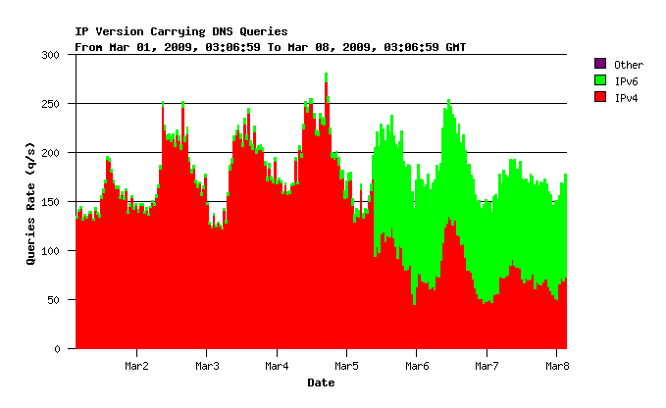
Turning on IPv6 on our DNS resolvers

Slide 15
Is there a Happy Ending for IPv6?
The pressures and obstacles to take-up are mostly the same as they were 10 years ago…
There isn’t much more we as an Academic & Research network can do now…
…it’s kind of over to YOU! and the Googles, Facebooks, Amazons, Twitters and mobile & ISP operators of the world to decide what kind of Internet you want.
Notes:
I think in HEAnet we’re a little burnt out when it comes to IPv6.

Slide 16
Questions?
Thank you!

Slide 17
Additional Resources
Irish IPv6 Task Force: http://www.ie.ipv6tf.org/
                IPv6 Fundamentals: http://www.ie.ipv6tf.org/IPv6_fundamentals.pdf
  IPv6 Deployment and Strategy:
  http://www.ie.ipv6tf.org/ipv6_deployment_strategy.pdf
IPv6 Dissemination & Exploitation tutorials: https://www.6diss.org/tutorials/
IPv6 Network Administration (O’Reilly Press) http://shop.oreilly.com/product/9780596009342.do
Notes:
Some links to other slide sets and resources the Irish IPv6 Task Force and the 6DISS group put together.

