Slide 1
Notes:
Logo Slide
- same color background as our web app
- layout is based on a a 40-px grid

Slide 2

SDN all the things
Jose Leitao
Production Network Engineer - NIE
Notes:
choose one - delete this text

Slide 3

© 2016 Facebook | Dublin | Credits: Eric Heunthep – LOL http://bit.ly/1l4ffGp http://creativecommons.org/licenses/by-sa/3.0/deed.en
Notes:
https://www.flickr.com/photos/neolao/3105372669/

Slide 4
Myths of Network Automation
Jose Leitao
Production Network Engineer - NIE
Notes:
choose one - delete this text

Slide 5

© 2016 Facebook | Dublin | Credits: Nicolas Raymond – Crossing Road Grunge Sign, Welsh Dragon - http://bit.ly/1RB8xq0 http://creativecommons.org/licenses/by-sa/3.0/deed.en
Notes:
https://www.flickr.com/photos/80497449@N04/8679231413/in/photolist-edXk7V

Slide 6
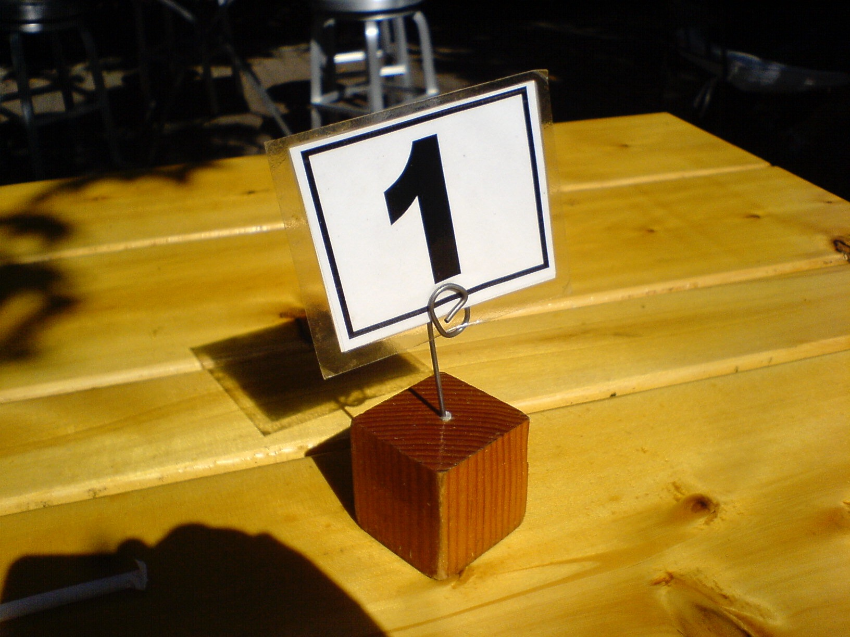
© 2016 Facebook | Dublin | Credits: Brandon Schauer– LOL http://bit.ly/1PqcLdH http://creativecommons.org/licenses/by-sa/3.0/deed.en
Notes:
https://www.flickr.com/photos/brandonschauer/4038957918/

Slide 7
“Automation Fixes Everything”
© 2016 Facebook | Dublin | Credits: Brandon Schauer– LOL http://bit.ly/1PqcLdH http://creativecommons.org/licenses/by-sa/3.0/deed.en
Notes:
https://www.flickr.com/photos/brandonschauer/4038957918/

Slide 8

© 2016 Facebook | Dublin | Credits: Tom Hilton - NOPE http://bit.ly/1Zrf1vP http://creativecommons.org/licenses/by-sa/3.0/deed.en
Notes:
https://www.flickr.com/photos/tomhilton/5599966437

Slide 9
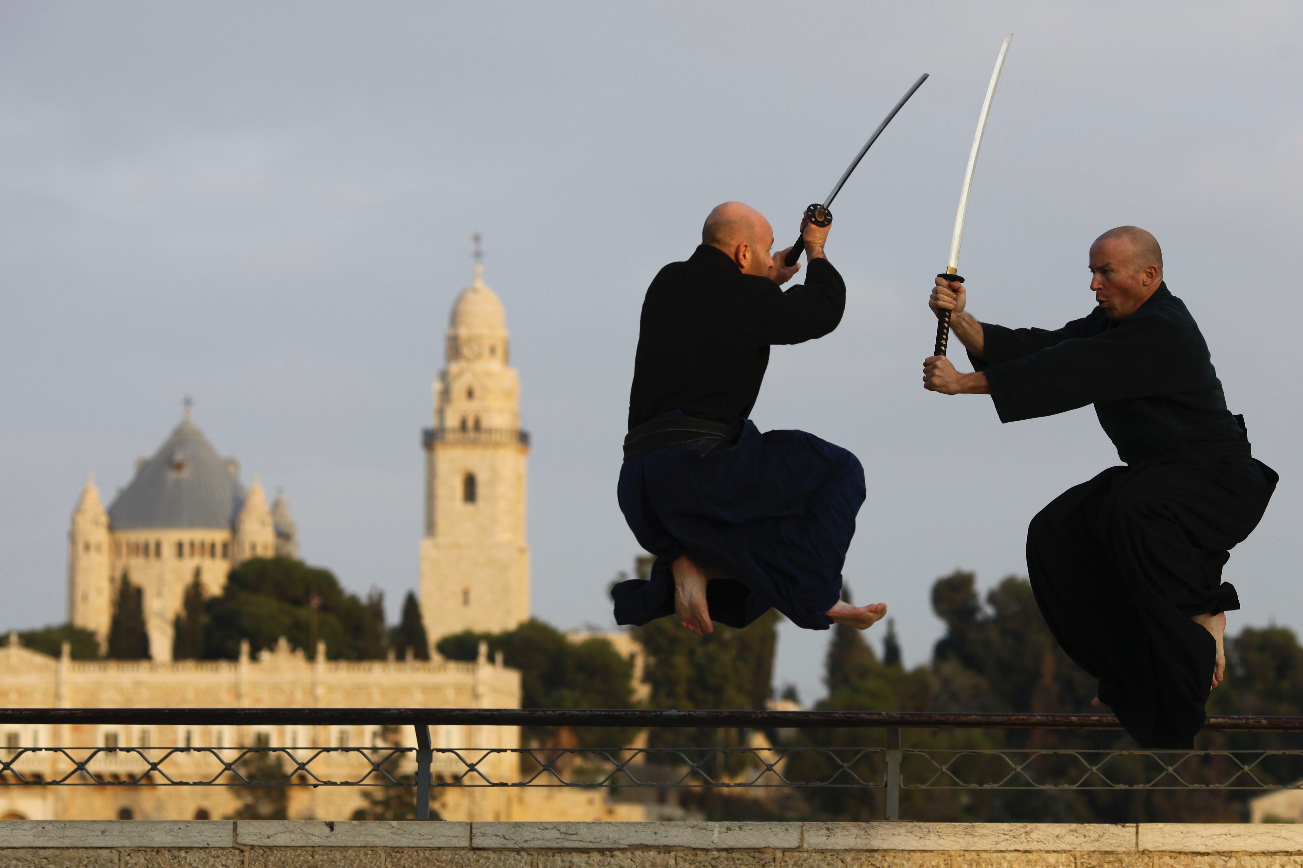
© 2016 Facebook | Dublin | Credits: Akban Martial arts academy – Sunset jumping in kukishinden ryu sword kata http://bit.ly/1OO31Oa http://creativecommons.org/licenses/by-sa/3.0/deed.en
Notes:
https://www.flickr.com/photos/akban/4299727995/

Slide 10

© 2016 Facebook | Dublin | Credits: DVIDSHUB – Royal Engineers complete construction of Afghan Local Police station in Helmand capital http://bit.ly/1Sh9uUl http://creativecommons.org/licenses/by-sa/3.0/deed.en
Notes:
https://www.flickr.com/photos/dvids/6005968763/

Slide 11

© 2016 Facebook | Dublin | Credits: Thomas Galvez – Examination http://bit.ly/1IHEmIx http://creativecommons.org/licenses/by-sa/3.0/deed.en
Notes:
https://www.flickr.com/photos/togawanderings/14212266277/

Slide 12
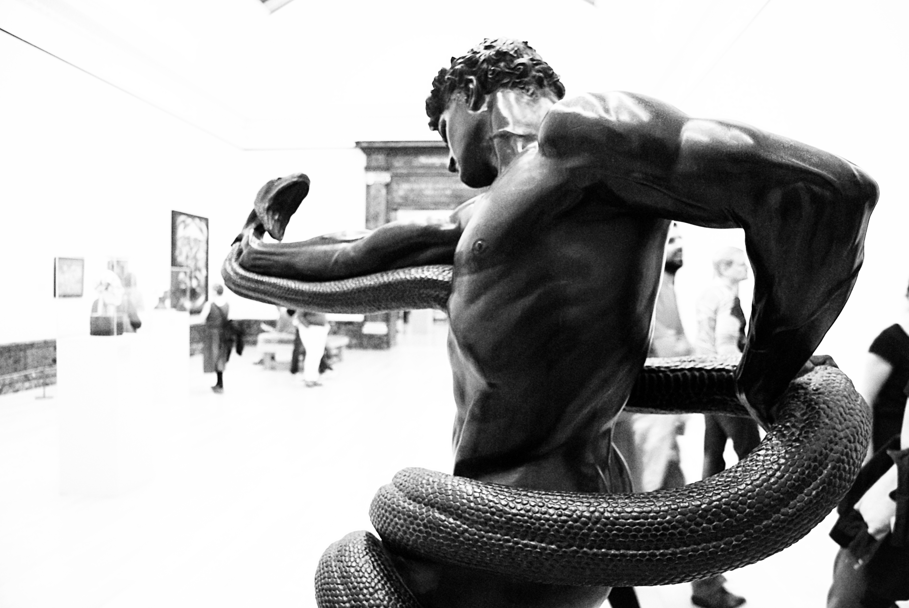
© 2016 Facebook | Dublin | Credits: Carmen Escobar Carrio – An Athlete Wrestling with a Python http://bit.ly/1OZW9PP http://creativecommons.org/licenses/by-sa/3.0/deed.en
Notes:
https://www.flickr.com/photos/caracolquiscol/6924461783/

Slide 13
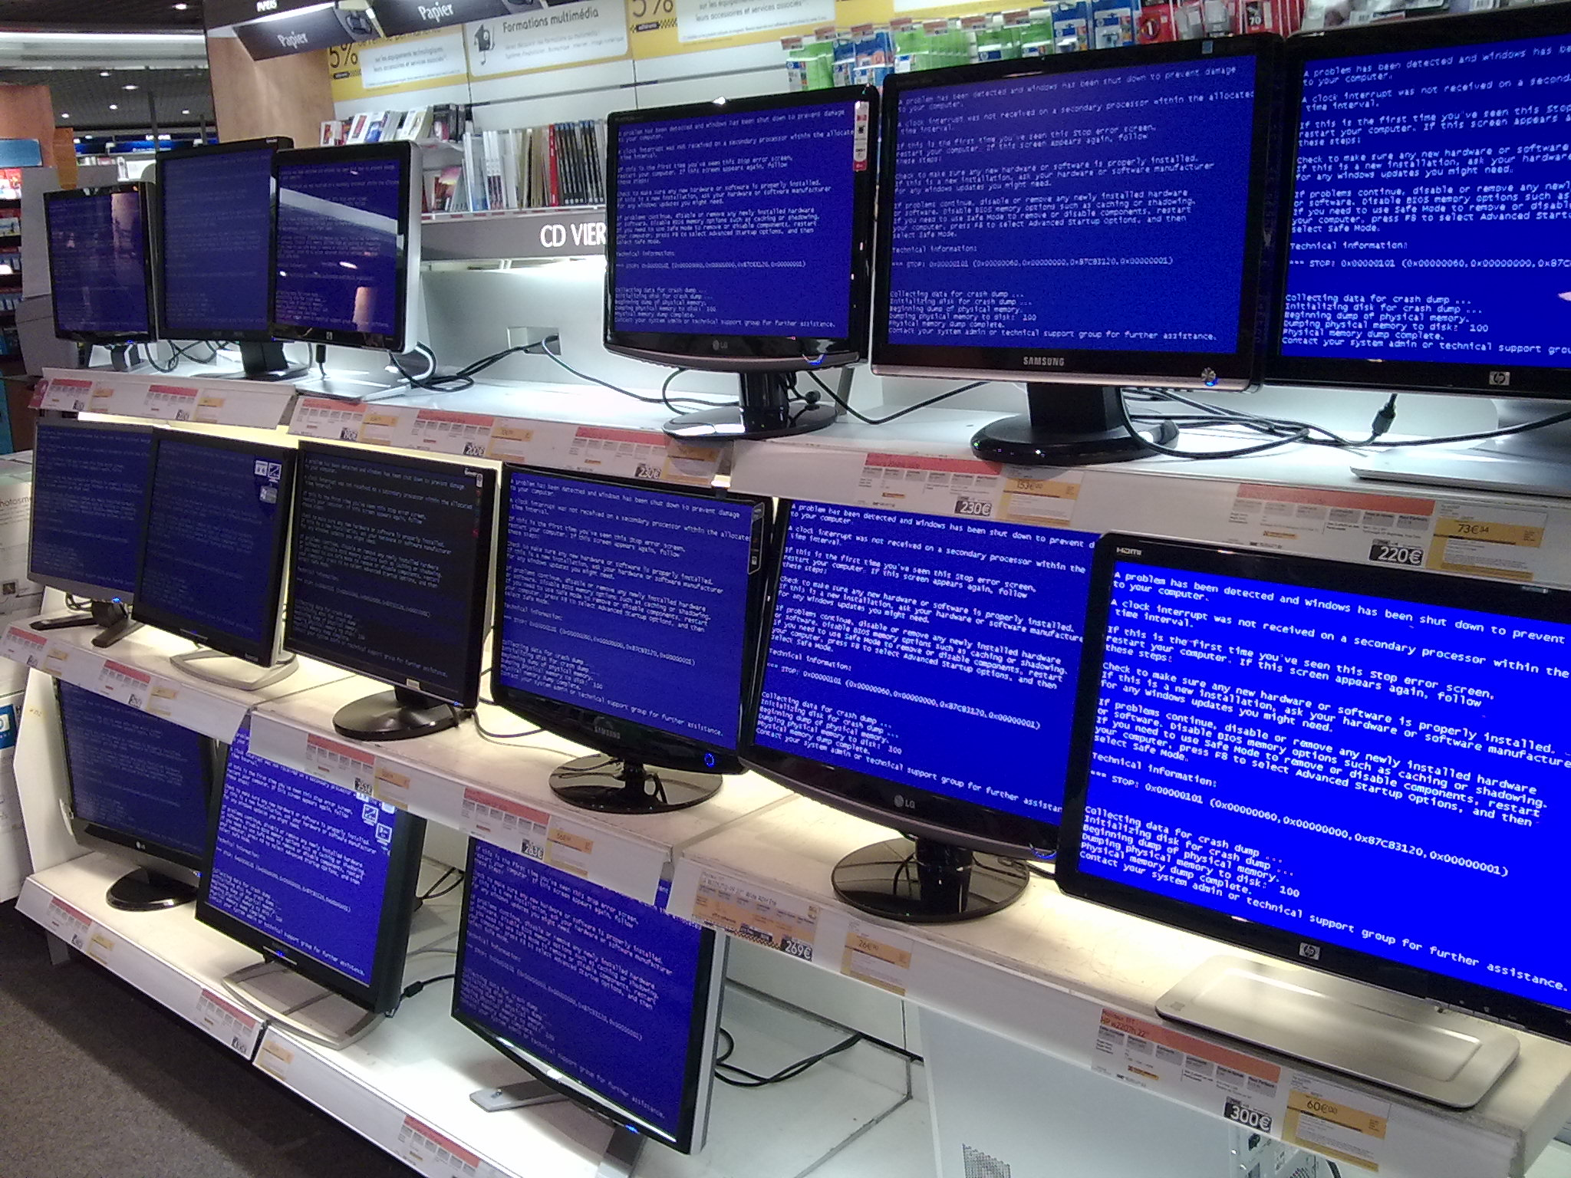
© 2016 Facebook | Dublin | Credits: Edouard– BSOD http://bit.ly/1Q3wVyT http://creativecommons.org/licenses/by-sa/3.0/deed.en
Notes:
https://www.flickr.com/photos/madko77/2648802969/

Slide 14
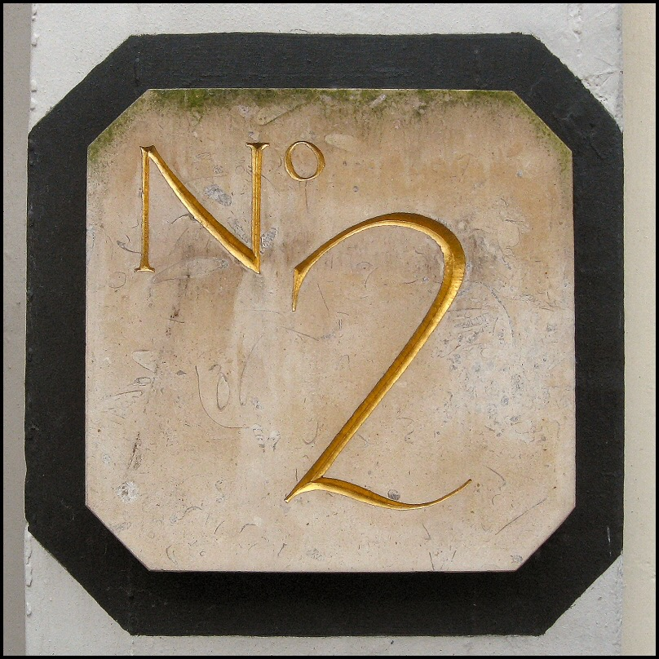
© 2016 Facebook | Dublin | Credits: Brian – 2 http://bit.ly/1mVQazq http://creativecommons.org/licenses/by-sa/3.0/deed.en
Notes:
https://www.flickr.com/photos/lincolnian/2291230629/

Slide 15
“Big networks have fixed everything”
© 2016 Facebook | Dublin | Credits: Brian – 2 http://bit.ly/1mVQazq http://creativecommons.org/licenses/by-sa/3.0/deed.en
Notes:
https://www.flickr.com/photos/lincolnian/2291230629/

Slide 16

© 2016 Facebook | Dublin | Credits: Juliana Coutinho –http://bit.ly/1SOeeQH http://creativecommons.org/licenses/by-sa/3.0/deed.en
Notes:
https://www.flickr.com/photos/ngmmemuda/4223189009

Slide 17
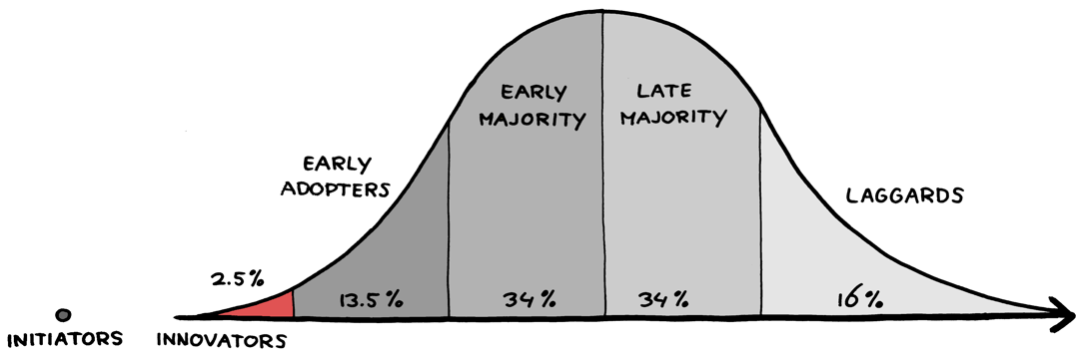
© 2016 Facebook | Dublin | Credits: Jurgen Appelo – Adoption Curve-Innovators http://bit.ly/1l4klSW http://creativecommons.org/licenses/by-sa/3.0/deed.en
Notes:
https://www.flickr.com/photos/jurgenappelo/6943418811/

Slide 18
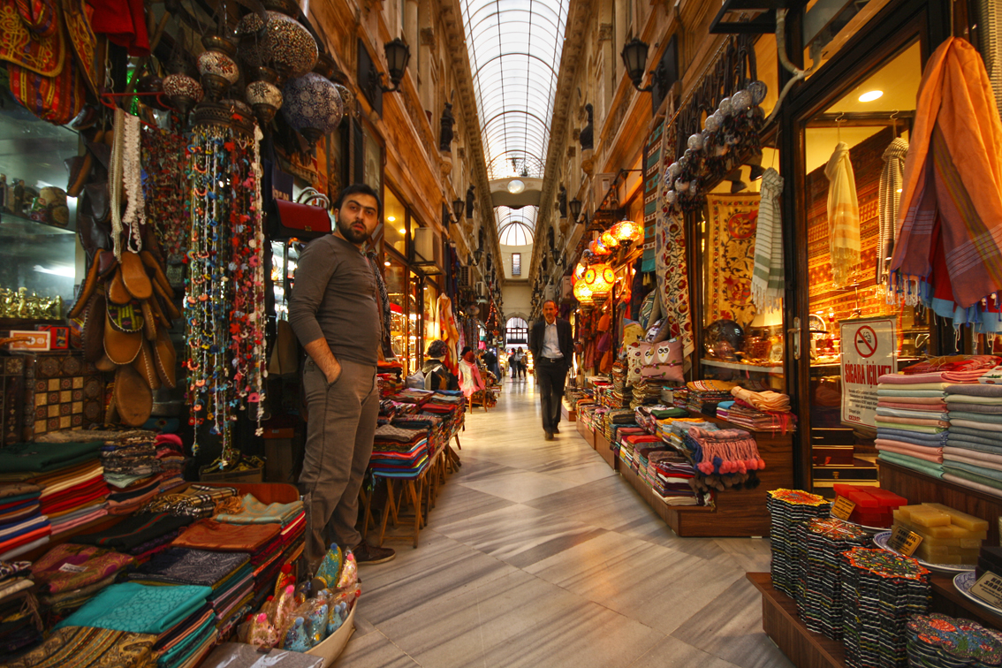
© 2016 Facebook | Dublin | Credits: Miguel Virkkunen Carvalho – Traditional Arcade http://bit.ly/1OpNbFK http://creativecommons.org/licenses/by-sa/3.0/deed.en
Notes:
https://www.flickr.com/photos/miguelvirkkunen/14265343841/

Slide 19
JSON/XML via CLI
NETCONF / YANG
REST APIs
Linux unleashed
Openconfig
Vendor options
Interacting with network gear

Slide 20




© 2016 Facebook | Dublin | Credits: ?
Notes:
https://www.flickr.com/photos/madko77/2648802969/ < not right link

Slide 21
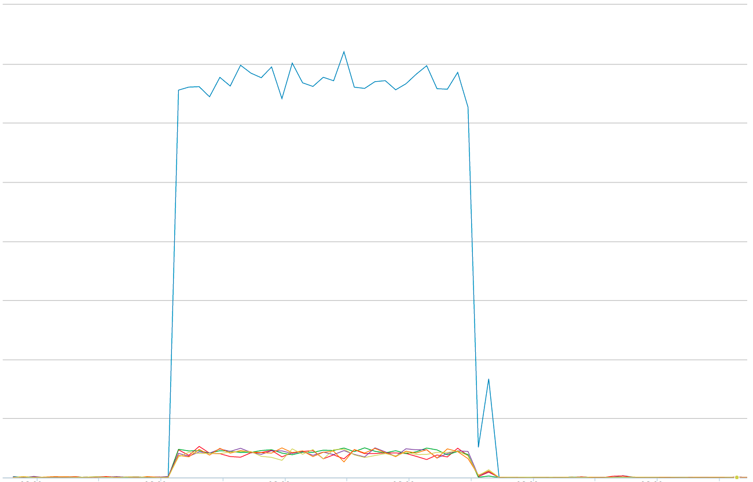

Slide 22
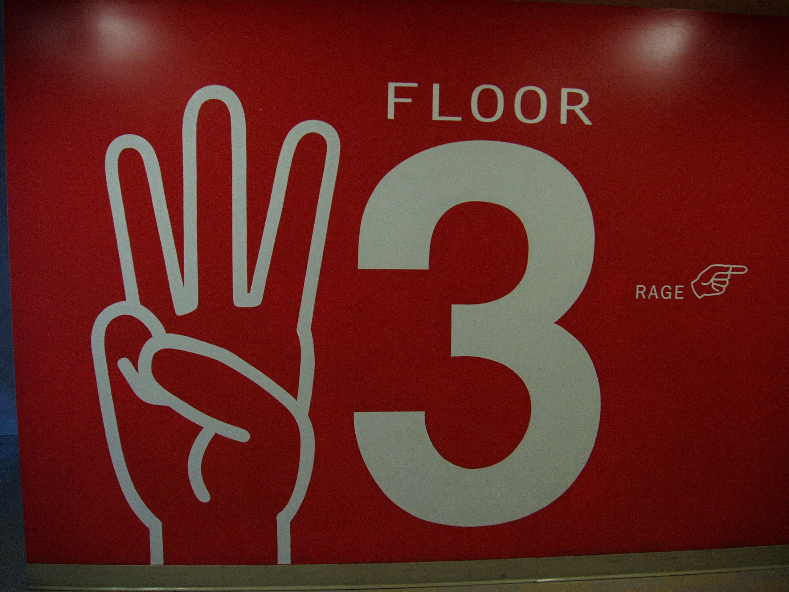
© 2016 Facebook | Dublin | Credits: Nicolas Vigier – Three! http://bit.ly/1TTxpa5 http://creativecommons.org/licenses/by-sa/3.0/deed.en
Notes:
https://www.flickr.com/photos/boklm/486646798/

Slide 23
“This is great but it doesn’t apply to me”
© 2016 Facebook | Dublin | Credits: Nicolas Vigier – Three! http://bit.ly/1TTxpa5 http://creativecommons.org/licenses/by-sa/3.0/deed.en
Notes:
https://www.flickr.com/photos/boklm/486646798/

Slide 24
Automation (one month)
3.37b
750K
0.99%
99.6%

Slide 25
Automation (one month)
750,000 * 2 = 1,500,000
1,500,000 / 60 = 25,000
25,000 / 160

Slide 26
Automation (one month)
+150
750,000 * 2 = 1,500,000
1,500,000 / 60 = 25,000
25,000 / 160

Slide 27

© 2016 Facebook | Dublin | Credits: ?
Notes:
CREDITS?

Slide 28

Notes:
https://www.flickr.com/photos/madko77/2648802969/

Slide 29

© 2016 Facebook | Dublin | Credits: Say Thanks - Various Artists - https://www.facebook.com/stickers/1407088142851607/

Slide 30
Notes:
Logo Slide
- same color background as our web app
- layout is based on a a 40-px grid
- logo at 240x240px

